Slide 1
Ms. Hansi Udapola
B.Sc. (Special) in Computer Science
Lecturer (Probationary)
Department of Software Engineering
Faculty of Computing and Technology.
_{E-Mail – hansi@kln.ac.lk}

Slide 2
Reference: https://www.w3schools.com/

Slide 3
HTML Links

Slide 4
HTML Links
HTML uses a hyperlink to link to another document on the web.
HTML uses the <a> (anchor> tag to create a link to another document.
An anchor can point to any resource on the web:
An HTML page
An Image
A sound File
A Movie etc.
Syntax
The <a> tag is used to create an anchor to link from
The href attribute is used to address the document to link
Ex: Anchor defines a link to google ->
<a href=“https://www.google.com/”> Visit Google! </a>

Slide 5
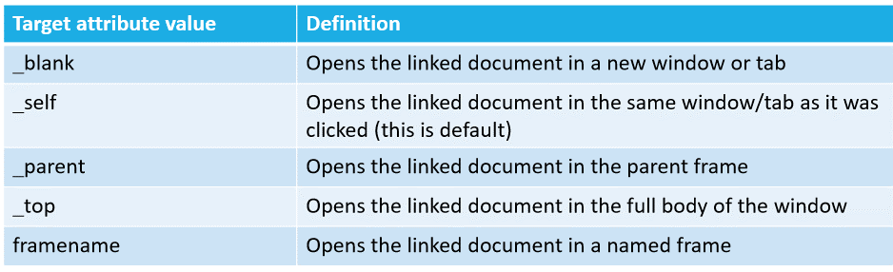
The Target attribute is used to define where the linked document will be opened.
The below link will open the document in a new browser window or tab :

Slide 6
The anchor Tag and the Name attribute
Used to create a named anchor
When using named anchors we can create links that can jump directly into a specific section on a page, instead of letting the user scroll around to find what he/she is looking for.
Syntax to ‘Named Anchor’
Syntax to link an Name Anchor
<a name=“label”> Text to be display! </a>
<a href=“#label”> Text to be display! </a>

Slide 7
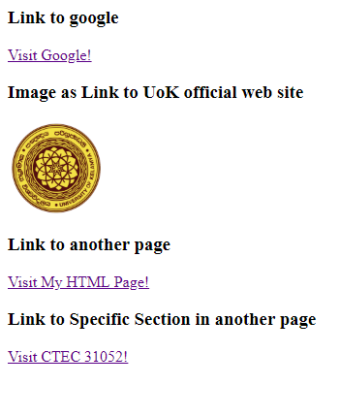
<h3>Link to google</h3>
<p>
<a href="https://www.google.com/" target="_top">Visit Google!</a>
</p>
<h3>Image as Link to UoK official web site</h3>
<p>
<a href="https://www.kln.ac.lk/" target="_blank">
<img src="Kelaniya.png" style="width:100;"/>
</a>
</p>
<h3>Link to another page</h3>
<p>
<a href="0_linktemp.html" target="_self">Visit My HTML Page!</a>
</p>
<h3>Link to Specific Section in another page</h3>
<p>
<a href="0_linktemp.html#CTEC31052" target="_top">Visit CTEC 31052!</a>
</p>

Slide 8
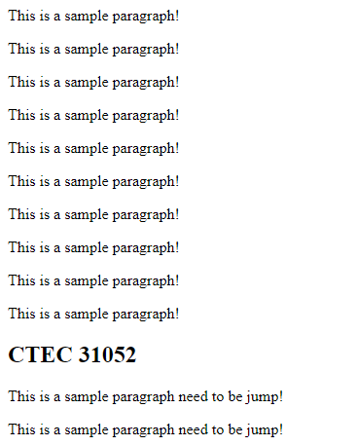
<a name=“CTEC31052">
<h2>CTEC 31052</h2>
</a>
<p> This is a sample paragraph need to be jump!</p>
<p> This is a sample paragraph need to be jump!</p>
Name of the anchor is CTEC 31052

Slide 9
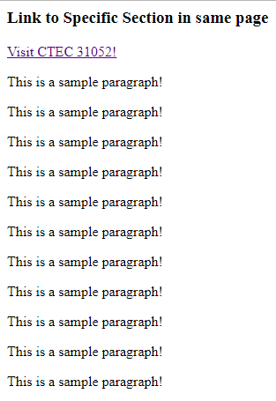
Link to the section in the same page which have “CTEC31052” as the Name of the anchor
<h3>Link to Specific Section in same page</h3>
<p>
<a href="#CTEC31052">Visit CTEC 31052!</a>
</p>
Check the URL: file:///D:/HTML/L5/0_linktemp.html#CTEC31052
fragment

Slide 10
Mailto link
mailto link is used to link to a mail message (it will only work if you have installed mail).
<p>
This is an email link:
<a href="mailto:example123@gmail.com?Subject=Course%20Materials" >
Send Mail
</a>
</p>
<p> This is another mailto link:
<a href="mailto:example123@gmail.com?cc=someoneelse@example.com&bcc=andsomeoneelse@example.com&subject=Course%20Advices&body=Study%20hard%20to%20get%20good%20results!">
Send mail!
</a>
</p>
<p>
<b>Note:</b> Spaces between words should be replaced by %20 to ensure that the browser will display the text properly.
</p>

Slide 11
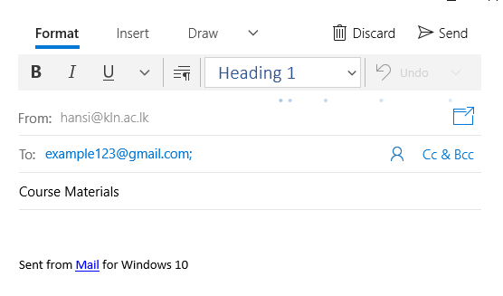
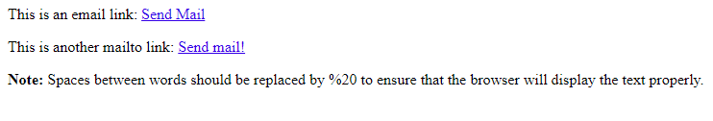
<a href="mailto:example123@gmail.com?Subject=Course%20Materials" >
Send Mail
</a>

Slide 12
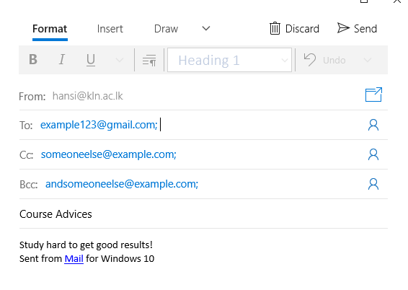
Advance ‘mailto’ Link
<a href="mailto:example123@gmail.com?cc=someoneelse@example.com&bcc=andsomeoneelse@example.com&subject=Course%20Advices&body=Study%20hard%20to%20get%20good%20results!">
Send mail!
</a>

Slide 13
HTML iframe

Slide 14
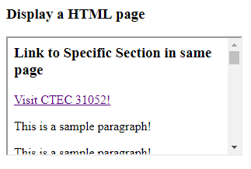
Inline Frame <iframe>
A Frame inside a HTML page known as Inline Frame ‘iframe’.
Example:
<iframe src=“URL”></iframe>
<h3>Display a HTML page</h3>
<iframe src="0_linktemp.html"></iframe>

Slide 15
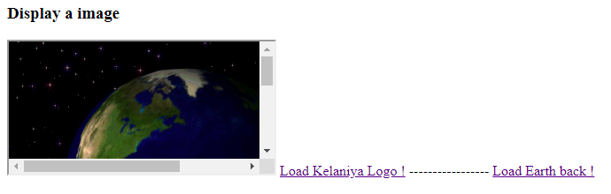
<h3>Display a image</h3>
<iframe name="commonFrame" style="width:400;height:400;" src="Earth.gif"></iframe>
<a href="Kelaniya.png" target="commonFrame">Load Kelaniya Logo !</a>
-----------------
<a href="Earth.gif" target="commonFrame">Load Earth back !</a>

Slide 16
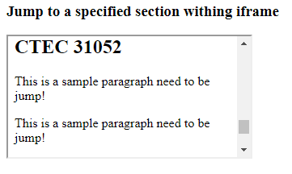
<h3>Jump to a specified section withing iframe</h3>
<iframe src="0_linktemp.html#CTEC31052">
</iframe>

Slide 17
HTML Image

Slide 18


HTML Images
Images are defined with the <img> standalone tag.
Src (Source) attribute defines the URL of the image
Syntax of defining and image;
You can use only the name of the image if html doc and image are in same directory path.
<img src=“url”>
<p>An image: Kelaniya.png<br>
<img src="Kelaniya.png" alt= "University of Kelaniya LOGO" style="width:100;height:100;">
</p>
<p>An Moving image: Earth.gif<br>
<img src="Earth.gif" style="width:20%;">
<!-- need to be in same path if you give image name only-->
</p>

Slide 19
HTML Paths
A file path defines the location of a file in a web site's folder structure.
File paths are used to link different files. They are:
Web pages
Images
Style sheets
JavaScripts
Path | Description
<img src=“Kelaniya.jpg"> | Kelaniya.jpg is located in the same folder as the current page.
<img src="images/firework.gif"> | firework.gif is located in the images folder in the current folder.
<img src="/images/picture.jpg"> | picture.jpg is located in the images folder at the root of the current web
<img src="../picture.jpg"> | picture.jpg is located in the folder one level up from the current folder

Slide 20
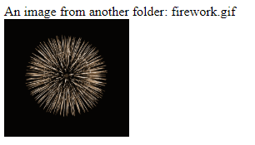

Insert an image in different location
<p>An image from another folder: firework.gif <br>
<img src="images/firework.gif" style="width:150;">
</p>
<p>An image from W3School: ie.gif <br>
<img src="https://www.w3schools.com/images/ie.gif" style="width:50;">
</p>

Slide 21
Adjust images to different sizes
Use “height” & “width” attributes to adjust the image width and height
Can be used percentages and pixel values to set the image size. (10% -> screen width/height * 0.1)
<img src="Kelaniya.png" width="100" height="100" >
<img src="Kelaniya.png" width=“10%” height=“10%” >
<img src="Kelaniya.png" width=“120” >
Automatically adjust the height by keeping same proportion of the image. (avoid vertical or horizontal Stretch )

Slide 22
The “alt” Attribute
Tells the reader what he or she is missing on a page if the browser can’t load images
Then browser will display the alternate text instead of the image
<img src=“boat.gif” alt=“Big Boat”>

Slide 23
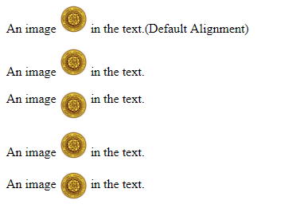
Aligning Images
Defining the text alignment within the text. Use the vertical-align property inside style tag.
vertical-align: baseline|length|sub|super|top|text-top|middle|bottom|text-bottom|initial|inherit;
<p> An image <img src="Kelaniya.png" style="width:115;"> in the text.(Default Alignment)</p>
<p> An image <img src="Kelaniya.png" style="width:115; vertical-align:baseline"> in the text.</p>
<p> An image <img src="Kelaniya.png" style="width:115; vertical-align:text-top"> in the text.</p>
<p> An image <img src="Kelaniya.png" style="width:115; vertical-align:text-bottom"> in the text.</p>
<p> An image <img src="Kelaniya.png" style="width:115; vertical-align:middle"> in the text.</p>

Slide 24
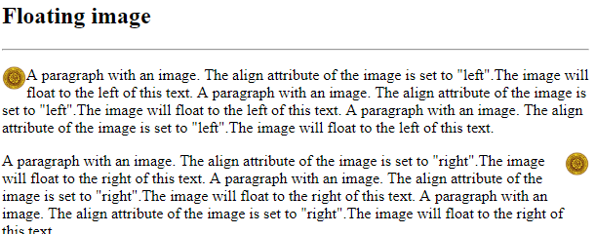
Floating Images
float: left| right | none |inherit;
<p><img src="Kelaniya.png" style="width:25;float:left" >
A paragraph with an image. The align attribute of the image is set to "left".The image will float to the left of this text. A paragraph ……
</p>
<p><img src="Kelaniya.png" style="width:25;float:right" >
A paragraph with an image. The align attribute of the image is set to "right".The image will float to the right of this text. A paragraph with an image……..
</p>

Slide 25
Make a hyperlink of an image
Use image as a hyperlink
<a href=“http://www.kln.ac.lk”>
<imgsrc=“KelaniLogo.png” alt=“UokLogo”>
</a>

Slide 26
Turn an image into an image map
<p>
Move the mouse over the image, and look at the status bar to see how the coordinates change.
</p>
<p>
<a href="images/space.jpg">
<img src="images/space.jpg" ismap style="width:720;height:540">
</a>
</p>

Slide 27
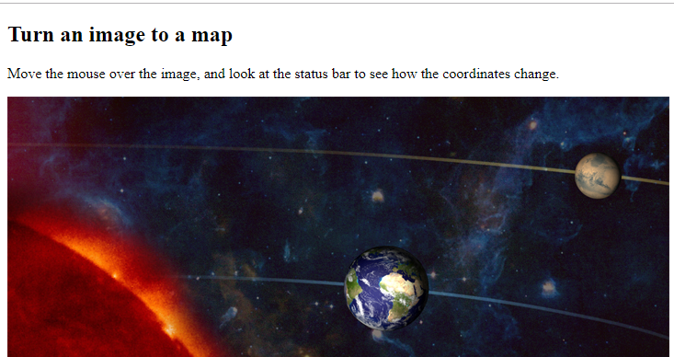
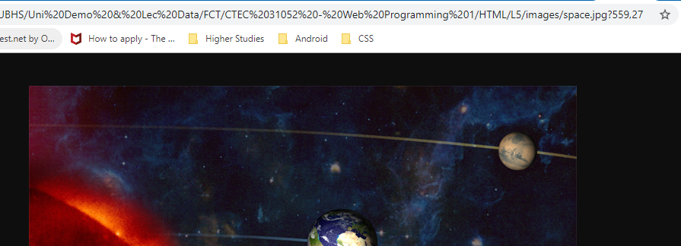
Click on image
Display the coordinates of the image that user clicked in URL

Slide 28
Create an Image Map
<img src="images/space.jpg" style="width:720;height:540" alt="Planets" usemap="#planetmap">
<map name="planetmap">
<area shape="rect" coords="0,134,300,540" alt="Sun" href="images/sun.jpg">
<area shape="circle" coords="410,208,45" alt="Earth" href="images/earth1.jpg">
<area shape="circle" coords="640,88,23" alt="Venus" href="images/moon.jpg">
<!--area shape="poly" coords="x1,y1,x2,y2,...,xn,yn" alt="Image1" href="images/star.jpg"-->
</map>

Slide 29
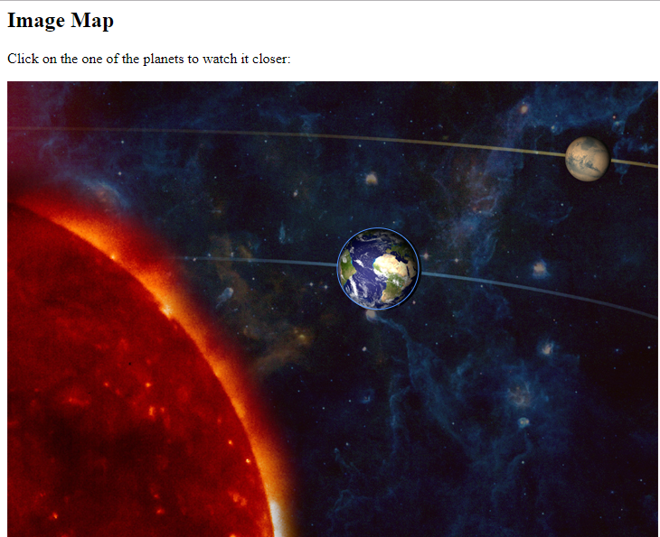

Click on specified area in image open given source

Slide 30
HTML Table

Slide 31
HTML Table
Use the HTML <table>element to define a table
Use the HTML <tr>element to define a table row
Use the HTML <td>element to define a table data
Use the HTML <th>element to define a table heading
Use the HTML <caption>element to define a table caption
Use the CSS borderproperty to define a border
Use the CSS border-collapseproperty to collapse cell borders

Slide 32
HTML Table (contd)..
Use the CSS paddingproperty to add padding to cells
Use the CSS text-alignproperty to align cell text
Use the CSS border-spacingproperty to set the spacing between cells
Use the colspanattribute to make a cell span many columns
Use the rowspanattribute to make a cell span many rows
Use the idattribute to uniquely define one table

Slide 33
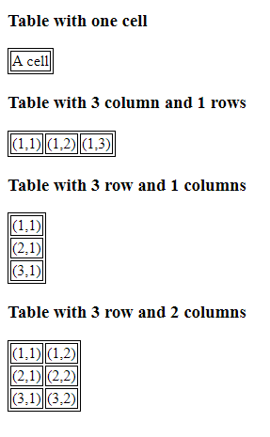
<h3>Table with one cell</h3>
<table>
<tr>
<td> A cell</td>
</tr>
</table>
<h3>Table with 3 column and 1 rows</h3>
<table>
<tr>
<td> (1,1)</td>
<td> (1,2)</td>
<td> (1,3)</td>
</tr>
</table>
<h3>Table with 3 row and 1 columns</h3>
<table>
<tr>
<td> (1,1)</td>
</tr>
<tr>
<td> (2,1)</td>
</tr>
<tr>
<td> (3,1)</td>
</tr>
</table>
<h3>Table with 3 row and 2 columns</h3>
<table>
<tr>
<td> (1,1)</td>
<td> (1,2)</td>
</tr>
<tr>
<td> (2,1)</td>
<td> (2,2)</td>
</tr>
<tr>
<td> (3,1)</td>
<td> (3,2)</td>
</tr>
</table>

Slide 34
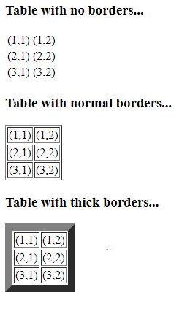
Table Borders
Note: The border attribute is not supported in HTML5. Use CSS instead as in previous slide.
<h3>Table with normal borders...</h3>
<table border="10">
<tr>
<td> (1,1)</td>
<td> (1,2)</td>
</tr>
<tr>
<td> (2,1)</td>
<td> (2,2)</td>
</tr>
<tr>
<td> (3,1)</td>
<td> (3,2)</td>
</tr>
</table>

Slide 35
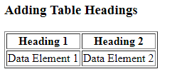
Headings in a Table
<h3>Adding Table Headings</h3>
<table border="1">
<tr>
<th>Heading 1</th>
<th>Heading 2</th>
</tr>
<tr>
<td>Data Element 1</td>
<td>Data Element 2</td>
</tr>
</table>

Slide 36
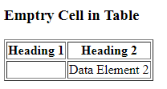
Empty cells in Table
<h3>Emptry Cell in Table</h3>
<table border="1">
<tr>
<th>Heading 1</th>
<th>Heading 2</th>
</tr>
<tr>
<td>&nbsp;</td> <!--EmptyCell-->
<td>Data Element 2</td>
</tr>
</table>

Slide 37
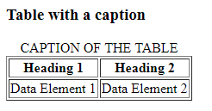
Table with a caption
<h3>Table with a caption</h3>
<table border="1">
<caption>CAPTION OF THE TABLE</caption>
<tr>
<th>Heading 1</th>
<th>Heading 2</th>
</tr>
<tr>
<td>Data Element 1</td>
<td>Data Element 2</td>
</tr>
</table>

Slide 38
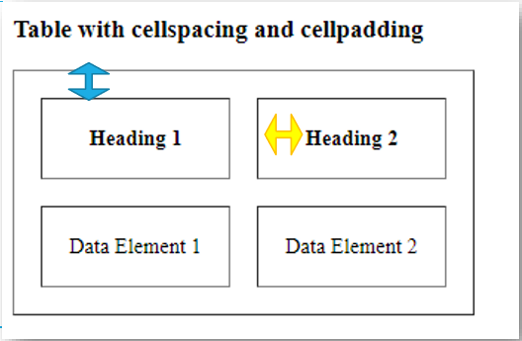
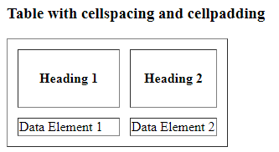
Add ‘border-spacing’ & ‘padding’
<h3>Table with cellspacing and cellpadding </h3>
<table border="1" style="border-spacing:12px">
<tr>
<th style="padding:25px">Heading 1</th>
<th>Heading 2</th>
</tr>
<tr>
<td>Data Element 1</td>
<td>Data Element 2</td>
</tr>
</table>

Slide 39
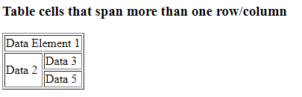
Cells span more than one row/column
<h3>Table cells that span more than one row/column </h3>
<table border="1">
<tr>
<td colspan="2">Data Element 1</td>
</tr>
<tr>
<td rowspan="2">Data 2</td>
<td>Data 3</td>
</tr>
<tr>
<td>Data 5</td>
</tr>
</table>

Slide 40
Tags inside the table
<h3>Tags inside the table</h3>
<table border="1">
<tr>
<th>Heading 1</th>
<th>Heading 2</th>
</tr>
<tr>
<td>
<p>This is a paragraph inside the cell</p>
</td>
<td>
<img src="Waterfall.jpg">
</td>
</tr>
<tr>
<td>
<p>Right cell contains another table</p>
</td>
<td>
<table border="1">
<tr>
<th>Heading 1</th>
<th>Heading 2</th>
</tr>
<tr>
<td>Data Element 1</td>
<td>Data Element 2</td>
</tr>
</table>
</td>
</tr>
</table>

Slide 41
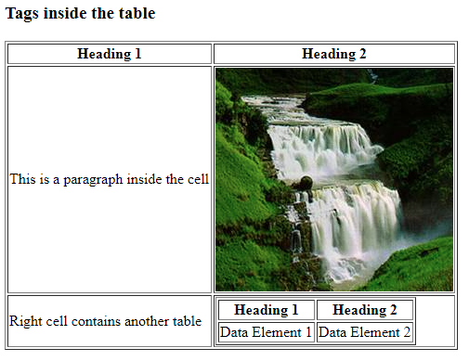

Slide 42
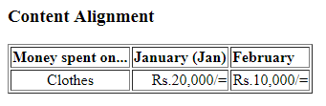
Content Alignment
<h3>Content Alignment</h3>
<table border="1">
<tr>
<th style="text-align:left">Money spent on...</th>
<th style="text-align:left">January (Jan)</th>
<th style="text-align:left">February</th>
</tr>
<tr>
<td style="text-align:center">Clothes</td>
<td style="text-align:right">Rs.20,000/=</td>
<td style="text-align:right">Rs.10,000/=</td>
</tr>
</table>

Slide 43
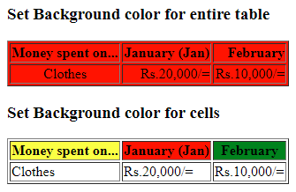
Set Background Colors
<h3>Set Background color for cells</h3>
<table border="1">
<tr>
<th style="background-color:yellow" >Money spent on...</th>
<th style="background-color:red">January (Jan)</th>
<th style="background-color:green">February</th>
</tr>
<tr>
<td>Clothes</td>
<td>Rs.20,000/=</td>
<td>Rs.10,000/=</td> </tr>
</table>
<table border="1" style="background-color:red">

Slide 44
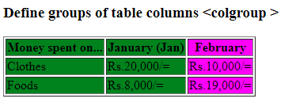
<colgroup>
The <colgroup> tag specifies a group of one or more columns in a table for formatting.
The <colgroup> tag is useful for applying styles to entire columns, instead of repeating the styles for each cell, for each row.
<table border="1">
<colgroup>
<col span="2" bgcolor="green">
<col bgcolor="magenta">
</colgroup>
<tr>
<th>Money spent on...</th>
<th>January (Jan)</th>
<th>February</th>
</tr>
…
</table>

Slide 45
tfoot, thead, tbody
The <tfoot> tag is used to group footer content in an HTML table.
The <tfoot> element is used in conjunction with the <thead> and <tbody> elements to specify each part of a table (footer, header, body).

Slide 46
HTML Table Tags
Tag | Description
<table> | Defines a table
<th> | Defines a header cell in a table
<tr> | Defines a row in a table
<td> | Defines a cell in a table
<caption> | Defines a table caption
<colgroup> | Specifies a group of one or more columns in a table for formatting
<col> | Specifies column properties for each column within a <colgroup> element
<thead> | Groups the header content in a table
<tbody> | Groups the body content in a table
<tfoot> | Groups the footer content in a table

Slide 47
HTML Lists

Slide 48
HTML Lists
Use <ol> tag to add an ordered List
Use <ul> tag to add an unordered List
Use <dl> tag to add a definition List
Use <dt> tag to define data element in a Definition List
Use <dd> tag to define data definition in Definition List

Slide 49
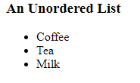
An Unordered List
<h3>An Unordered List</h3>
<ul>
<li>Coffee</li>
<li>Tea</li>
<li>Milk</li>
</ul>

Slide 50
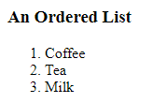
An Ordered List
<h3>An Ordered List</h3>
<ol>
<li>Coffee</li>
<li>Tea</li>
<li>Milk</li>
</ol>

Slide 51
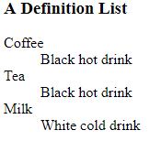
A Definition List
<h3>A Definition List</h3>
<dl>
<dt>Coffee</dt>
<dd>Black hot drink</dd>
<dt>Tea</dt>
<dd>Black hot drink</dd>
<dt>Milk</dt>
<dd>White cold drink</dd>
</dl>

Slide 52
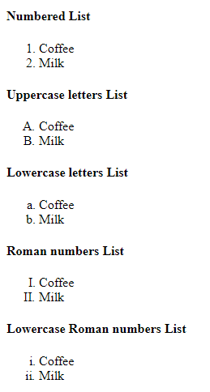
Different types of ordered lists
<h4>Numbered List</h4>
<ol style="list-style-type:1">
<li>Coffee</li>
<li>Milk</li>
</ol>
<h4>Uppercase letters List</h4>
<ol style="list-style-type:A">
<li>Coffee</li>
<li>Milk</li>
</ol>
<h4>Lowercase letters List</h4>
<ol style="list-style-type:a">
<li>Coffee</li>
<li>Milk</li>
</ol>
<h4>Roman numbers List</h4>
<ol style="list-style-type:I">
<li>Coffee</li>
<li>Milk</li>
</ol>
<h4>Lowercase Roman numbers List</h4>
<ol style="list-style-type:i">
<li>Coffee</li>
<li>Milk</li>
</ol>

Slide 53
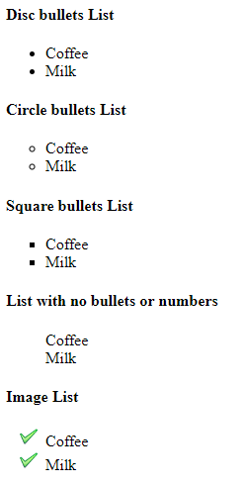
Different types of unordered lists
<h4>Disc bullets List</h4>
<ul style="list-style-type:disc">
<li>Coffee</li>
<li>Milk</li>
</ul>
<h4>Circle bullets List</h4>
<ul style="list-style-type:circle">
<li>Coffee</li>
<li>Milk</li>
</ul>
<h4>Square bullets List</h4>
<ul style="list-style-type:square">
<li>Coffee</li>
<li>Milk</li>
</ul>
<h4>List with no bullets or numbers</h4>
<ul style="list-style-type:none">
<li>Coffee</li>
<li>Milk</li>
</ul>
<h4>Image List</h4>
<ul style="list-style-image: url('chec.png')">
<li>Coffee</li>
<li>Milk</li>
</ul>

Slide 54
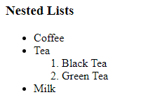
Nested Lists
<h3>Nested Lists</h3>
<ul>
<li>Coffee</li>
<li>Tea</li>
<ol>
<li>Black Tea</li>
<li>Green Tea</li>
</ol>
<li>Milk</li>
</ul>

Slide 55
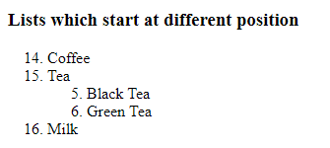
‘start’ Attribute in Ordered List
<h3>Lists which start at different position</h3>
<ol start="14">
<li>Coffee</li>
<li>Tea</li>
<ol start="5" style="list-style-type:I">
<li>Black Tea</li>
<li>Green Tea</li>
</ol>
<li>Milk</li>
</ol>

Slide 56
HTML Head

Slide 57
HTML <head>
The <head> element is a container for metadata (data about data) and is placed between the <html> tag and the <body> tag.
HTML metadata is data about the HTML document. Metadata is not displayed.
Metadata typically define the document title, character set, styles, links, scripts, and other meta information.
The following tags describe metadata:
<title>
<style>
<meta>
<link>
<script>
<base>

Slide 58
Meta data
Tag | Definition
<title> | defines the title of the document, and is required in all HTML/XHTML documents.
<style> | define style information for a single HTML page.
<link> | used to link to external style sheets.
<meta> | used to specify which character set is used, page description, keywords, author, and other metadata.
<script> | used to define client-side JavaScripts.
<base> | specifies the base URL and base target for all relative URLs in a page.

Slide 59
Meta data
The <meta> element is used to specify which character set is used, page description, keywords, author, and other metadata.
Metadata is used by browsers (how to display content), by search engines (keywords), and other web services.

Slide 60
Meta Data
Tag | Definition
charset="UTF-8" | Define the character set used
name="description“ content=“” | Define a description of your web page
name="keywords” content=“” | Define keywords for search engines
name="author“ content=“” | Define the author of a page
http-equiv="refresh" content=“#" | Refresh document every # seconds
name="viewport" content="width=device-width, initial-scale=1.0" | Gives the browser instructions on how to control the page's dimensions and scaling.

Slide 61
HTML Forms

Slide 62
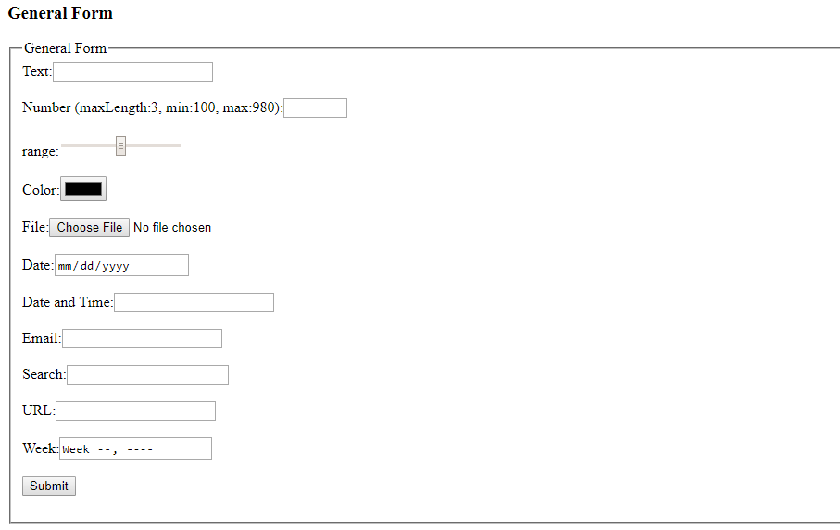
HTML Forms
An HTML form contains form elements.
Form elements are different types of input elements, like text fields, checkboxes, radio buttons, submit buttons, and more.

Slide 63
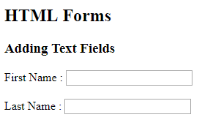
Adding Text Fields
<h3>Adding Text Fields</h3>
<form action="">
First Name : <input type="text" name="firstname"> <br> <br>
Last Name : <input type="text" name="lastname"> <br>
</form>

Slide 64
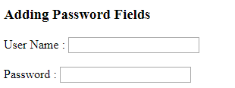
Adding Password Fields
<h3>Adding Password Fields</h3>
<form action="">
User Name : <input type="text" name="username"> <br> <br>
Password : <input type="password" name="pass"> <br>
</form>

Slide 65
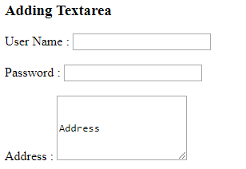
Adding Text Area
<form action="">
User Name : <input type="text" name="username"> <br> <br>
Password : <input type="password" name="pass"> <br> <br>
Address : <textarea name="address" cols="20" rows="5">
Address
</textarea><br>
</form>

Slide 66
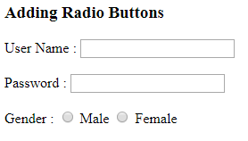
Adding Radio Buttons
<form action="">
User Name : <input type="text" name="username"> <br> <br>
Password : <input type="password" name="pass"> <br> <br>
Gender : <input type="radio" name="sex" value="male"> Male
<input type="radio" name="sex" value="female"> Female<br> <br>
</form>

Slide 67

Grouping the radio buttons
<input type="radio" name="sex" value="male"> Male
<input type="radio" name="sex" value="female"> Female<br> <br>
<input type="radio" name="sex1" value="female"> Test<br> <br>

Slide 68
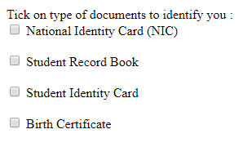
Adding Checkboxes
<input type="checkbox" name="privacy" value="nic"> National Identity Card (NIC)<br> <br>
<input type="checkbox" name="privacy" value="strecrd"> Student Record Book<br> <br>
<input type="checkbox" name="privacy" value="stdc"> Student Identity Card<br> <br>
<input type="checkbox" name="privacy" value="birth"> Birth Certificate<br> <br>

Slide 69

Checked Attribute
<input type="checkbox" name="privacy" value="nic" checked="checked"> National Identity Card (NIC)<br> <br>

Slide 70
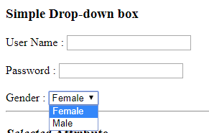
Simple Drop-down Box
<select name="gender">
<option name="female">Female</option>
<option name="male">Male</option>
</select>

Slide 71

selected Attribute
<select name="gender">
<option name="female">Female</option>
<option name="male" selected="selected">Male</option>
</select>

Slide 72
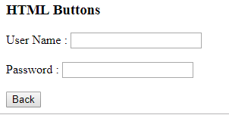
HTML Buttons
<h3>HTML Buttons</h3>
<form action="">
User Name : <input type="text" name="username"> <br> <br>
Password : <input type="password" name="pass"> <br> <br>
<input type="button" onclick="history.go(-1);" value="Back">
</form>

Slide 73
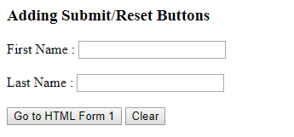
Adding submit & reset Buttons
<h3>Adding Submit/Reset Buttons</h3>
<form action="12_Forms.html" method="get">
First Name : <input type="text" name="firstname"> <br> <br>
Last Name : <input type="text" name="lastname"> <br> <br>
<input type="submit" value="Go to HTML Form 1">
<input type="reset" value="Clear">
</form>

Slide 74
POST & GET methods
GET-Requests data from a specified resource <form action="8_1_Forms.html" method="get"> check the URL
POST-Submits data to be processed to a specified resource

Slide 75
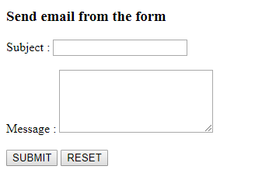
Send email from the form
<form action="MAILTO:someone@gmail.com" method="post" enctype="multipart/form-data">
Subject : <input name="subject" type="text"> <br> <br>
Message : <textarea name="textmsg" cols="25" rows="5"></textarea> <br> <br>
<input type="submit" value="SUBMIT">
<input type="reset" value="RESET">
</form>

Slide 76
HTML Form elements
<fieldset>
<legend>
General Form
</legend>
<form>
Text:<input maxlength="3" type="text" required><br> <br>
Number (maxLength:3, min:100, max:980):<input type="number" size="3" min=100 max="980"> <br> <br>
range:<input type="range" min=100 max="980"><br> <br>
Color:<input type="color"><br> <br>
File:<input type="file"><br> <br>
Date:<input type="date"><br> <br>
Date and Time:<input type="datetime"><br> <br>
Email:<input type="email"><br> <br>
Search:<input type="search"><br> <br>
URL:<input type="url"><br> <br>
Week:<input type="week"><br> <br>
<input type="submit"><br> <br>
</form>
</fieldset>

Slide 77
HTML Input Types
Here are the different input types you can use in HTML:
<input type="button"> <input type="checkbox"> <input type="color"> <input type="date"> <input type="datetime-local"> <input type="email"> <input type="file"> <input type="hidden"> <input type="image"> <input type="month"> <input type="password"> | <input type="radio"> <input type="range"> <input type="reset"> <input type="search"> <input type="submit"> <input type="tel"> <input type="text"> <input type="time"> <input type="url"> <input type="week">

Slide 78
HTML Form Elements
Tag | Description
<form> | Defines an HTML form for user input
<input> | Defines an input control
<textarea> | Defines a multiline input control (text area)
<label> | Defines a label for an <input> element
<fieldset> | Groups related elements in a form
<legend> | Defines a caption for a <fieldset> element
<select> | Defines a drop-down list
<optgroup> | Defines a group of related options in a drop-down list
<option> | Defines an option in a drop-down list
<button> | Defines a clickable button
<datalist> | Specifies a list of pre-defined options for input controls
<output> | Defines the result of a calculation

Slide 79
HTML5 Attributes
HTML5 added the following attributes for <input>:
autocomplete
autofocus
form
formaction
formenctype
formmethod
formnovalidate
formtarget
height and width
List
and the following attributes for <form>:
Autocomplete - specifies whether a form or input field should have autocomplete on or off. When autocomplete is on, the browser automatically completes the input values based on values that the user has entered before.
Novalidate - the form data should not be validated when submitted
min and max
multiple
pattern (regexp)
placeholder
required
step

Slide 80
autocomplete
specifies whether a form or input field should have autocomplete on or off.
When autocomplete is on, the browser automatically completes the input values based on values that the user has entered before.
Ex: https://www.w3schools.com/html/tryit.asp?filename=tryhtml5_input_autocomplete

Slide 81
autofocus
The autofocus attribute specifies that the input field should automatically get focus when the page loads.
Ex:
https://www.w3schools.com/html/tryit.asp?filename=tryhtml5_input_autofocus

Slide 82
The form Attribute
The form attribute specifies one or more forms an <input> element belongs to.

Slide 83
formaction
Specifies the URL of a file that will process the input control when the form is submitted.
The formaction attribute overrides the action attribute of the <form> element.
The formaction attribute is used with type="submit" and type="image".
Ex:
https://www.w3schools.com/html/tryit.asp?filename=tryhtml5_input_formaction

Slide 84
formenctype
The formenctype attribute specifies how the form data should be encoded when submitted (only for forms with method="post").
The formenctype attribute overrides the enctype attribute of the <form> element.
The formenctype attribute is used with type="submit" and type="image".

Slide 85
formmethod
The formmethod attribute defines the HTTP method for sending form-data to the action URL.
The formmethod attribute overrides the method attribute of the <form> element.
The formmethod attribute can be used with type="submit" and type="image".
Ex:
https://www.w3schools.com/html/tryit.asp?filename=tryhtml5_input_formmethod

Slide 86
formnovalidate
The formnovalidate attribute overrides the novalidate attribute of the <form> element.
The formnovalidate attribute can be used with type="submit".
Ex:
https://www.w3schools.com/html/tryit.asp?filename=tryhtml5_input_formnovalidate

Slide 87
formtarget
The formtarget attribute specifies a name or a keyword that indicates where to display the response that is received after submitting the form.
The formtarget attribute overrides the target attribute of the <form> element.
The formtarget attribute can be used with type="submit" and type="image".
Ex: https://www.w3schools.com/html/tryit.asp?filename=tryhtml5_input_formtarget

Slide 88
The list Attribute
The list attribute refers to a <datalist> element that contains pre-defined options for an <input> element.
<input list="browsers"> <datalist id="browsers"> <option value="Internet Explorer"> <option value="Firefox"> <option value="Chrome"> <option value="Opera"> <option value="Safari"> </datalist>

Slide 89
multiple
The multiple attribute specifies that the user is allowed to enter more than one value in the <input> element.
The multiple attribute works with the following input types: email, and file.
Ex:
https://www.w3schools.com/html/tryit.asp?filename=tryhtml5_input_multiple

Slide 90
pattern
The pattern attribute specifies a regular expression that the <input> element's value is checked against.
The pattern attribute works with the following input types: text, search, url, tel, email, and password.
pattern="[A-Za-z]{3}“
//should contains 3 alphabetic character in upper or lowercase
Ex: https://www.w3schools.com/html/tryit.asp?filename=tryhtml5_input_pattern

Slide 91
placeholder
The placeholder attribute specifies a hint that describes the expected value of an input field (a sample value or a short description of the format).
The hint is displayed in the input field before the user enters a value.
The placeholder attribute works with the following input types: text, search, url, tel, email, and password.
Ex:
https://www.w3schools.com/html/tryit.asp?filename=tryhtml5_input_placeholder

Slide 92
required
The required attribute specifies that an input field must be filled out before submitting the form.
The required attribute works with the following input types: text, search, url, tel, email, password, date pickers, number, checkbox, radio, and file.
Ex:
https://www.w3schools.com/html/tryit.asp?filename=tryhtml5_input_required

Slide 93
step
The step attribute specifies the legal number intervals for an <input> element.
Example: if step="3", legal numbers could be -3, 0, 3, 6, etc.
Ex:
https://www.w3schools.com/html/tryit.asp?filename=tryhtml5_input_step

Slide 94


https://padlet.com/hansi3/CTEC31052

